Slide 2

Penryn campus micro-grid project
R&D facility for SMEs
Proof of concept
Teaching facility
Research facility for academics
Matlab-Simulink simulation of new smart products

Slide 3
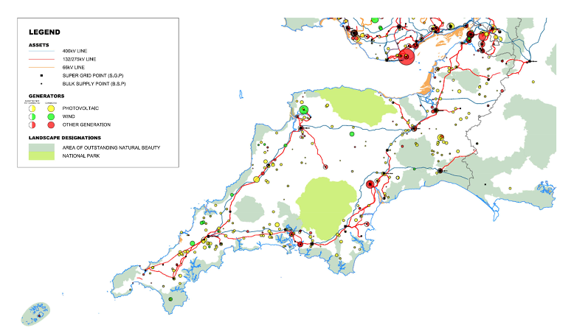
Challenges
Owned by Western Power Distribution
400 kVA transmission network until Indian Queens, then predominantly serviced by 33 kVA/11 kVA distribution network;
F-route reached its capacity in March 2015, situated at the boundary between the S West peninsula and the main interconnected transmission network, this will not be reinforced until Hinckley Point C is commissioned…
Thermal constraints as well as voltage are common place across the regional network, causing barriers to deployment of renewable generation and energy storage
AC side energy storage as yet unrecognised in the Grid Code; resulting in it being treated as generation

Slide 4

Positive News
Despite domestic energy consumption rising by 3.4%, CO² Emissions fell by 9.1 Million Tonnes between 2017-2018
In 2018, 33% of Generated electrical energy was from Renewable Sources (by Q1 2019 the figure had increased to 35.8%)
An increase of 3.8% on 2017 levels
44.3 GW of renewable energy capacity across the UK
5.2% of capacity is now on-shore wind generation
28% of capacity is off-shore wind generation

Slide 5
Opportunities
Deployment of energy storage devices into the distribution network could be the answer to decongesting the grid allowing for further renewable energy deployment
Current financial models based on available income streams show payback models of approx. 14 years
Bank holiday weekend, May 2019; Record 11 hours of continuous negative electricity pricing saw £MWh drop to -£12.16/MWh
On Sunday May 26th National Grid spent £6.6M on Grid Balancing and Flexibility Services
According to Cornwall Insight (research and analysis firm) by 2034,10% of all half hourly settlement periods could produce negative pricing
As more and more fossil fuel powered plant comes off line, systematic spinning inertia lowers and grid frequency maintenance becomes a service the System Opperator must procure from new sources

Slide 6
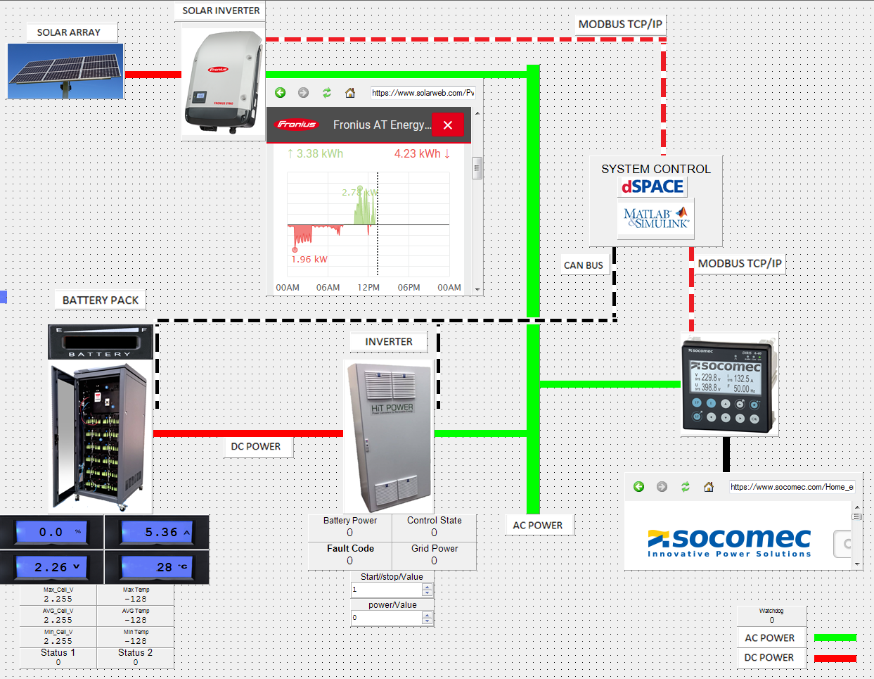
Penryn campus micro-grid project

Slide 7
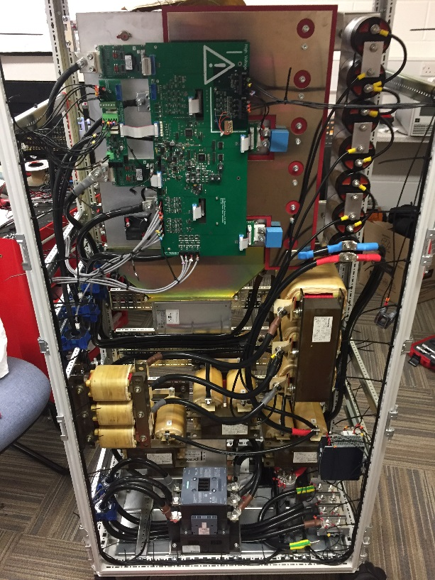
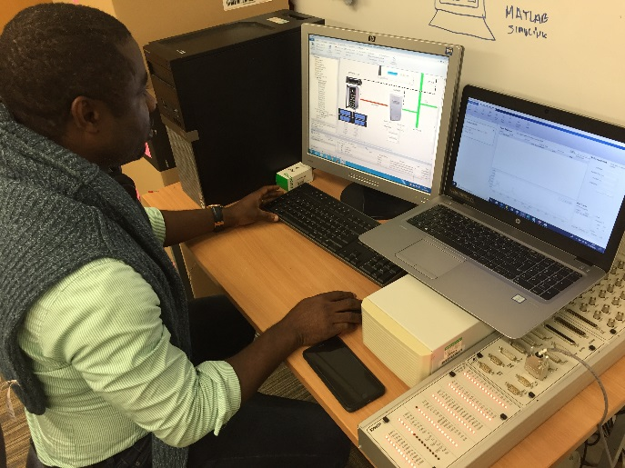
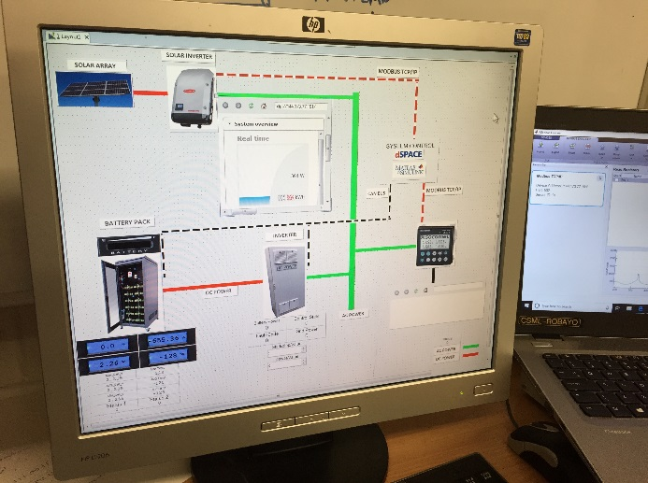
Penryn campus micro-grid project
SMEs engaged in R&D work to explore and develop
Local monitoring and smart control of micro-grid; both loads and generation
Demand Side Management
Vehicle to Grid control and monitoring systems
Aggregated supervisory platform, signalling, monitoring and control of multiple site
Smart contracting; peer to peer energy trading

